Slide 1
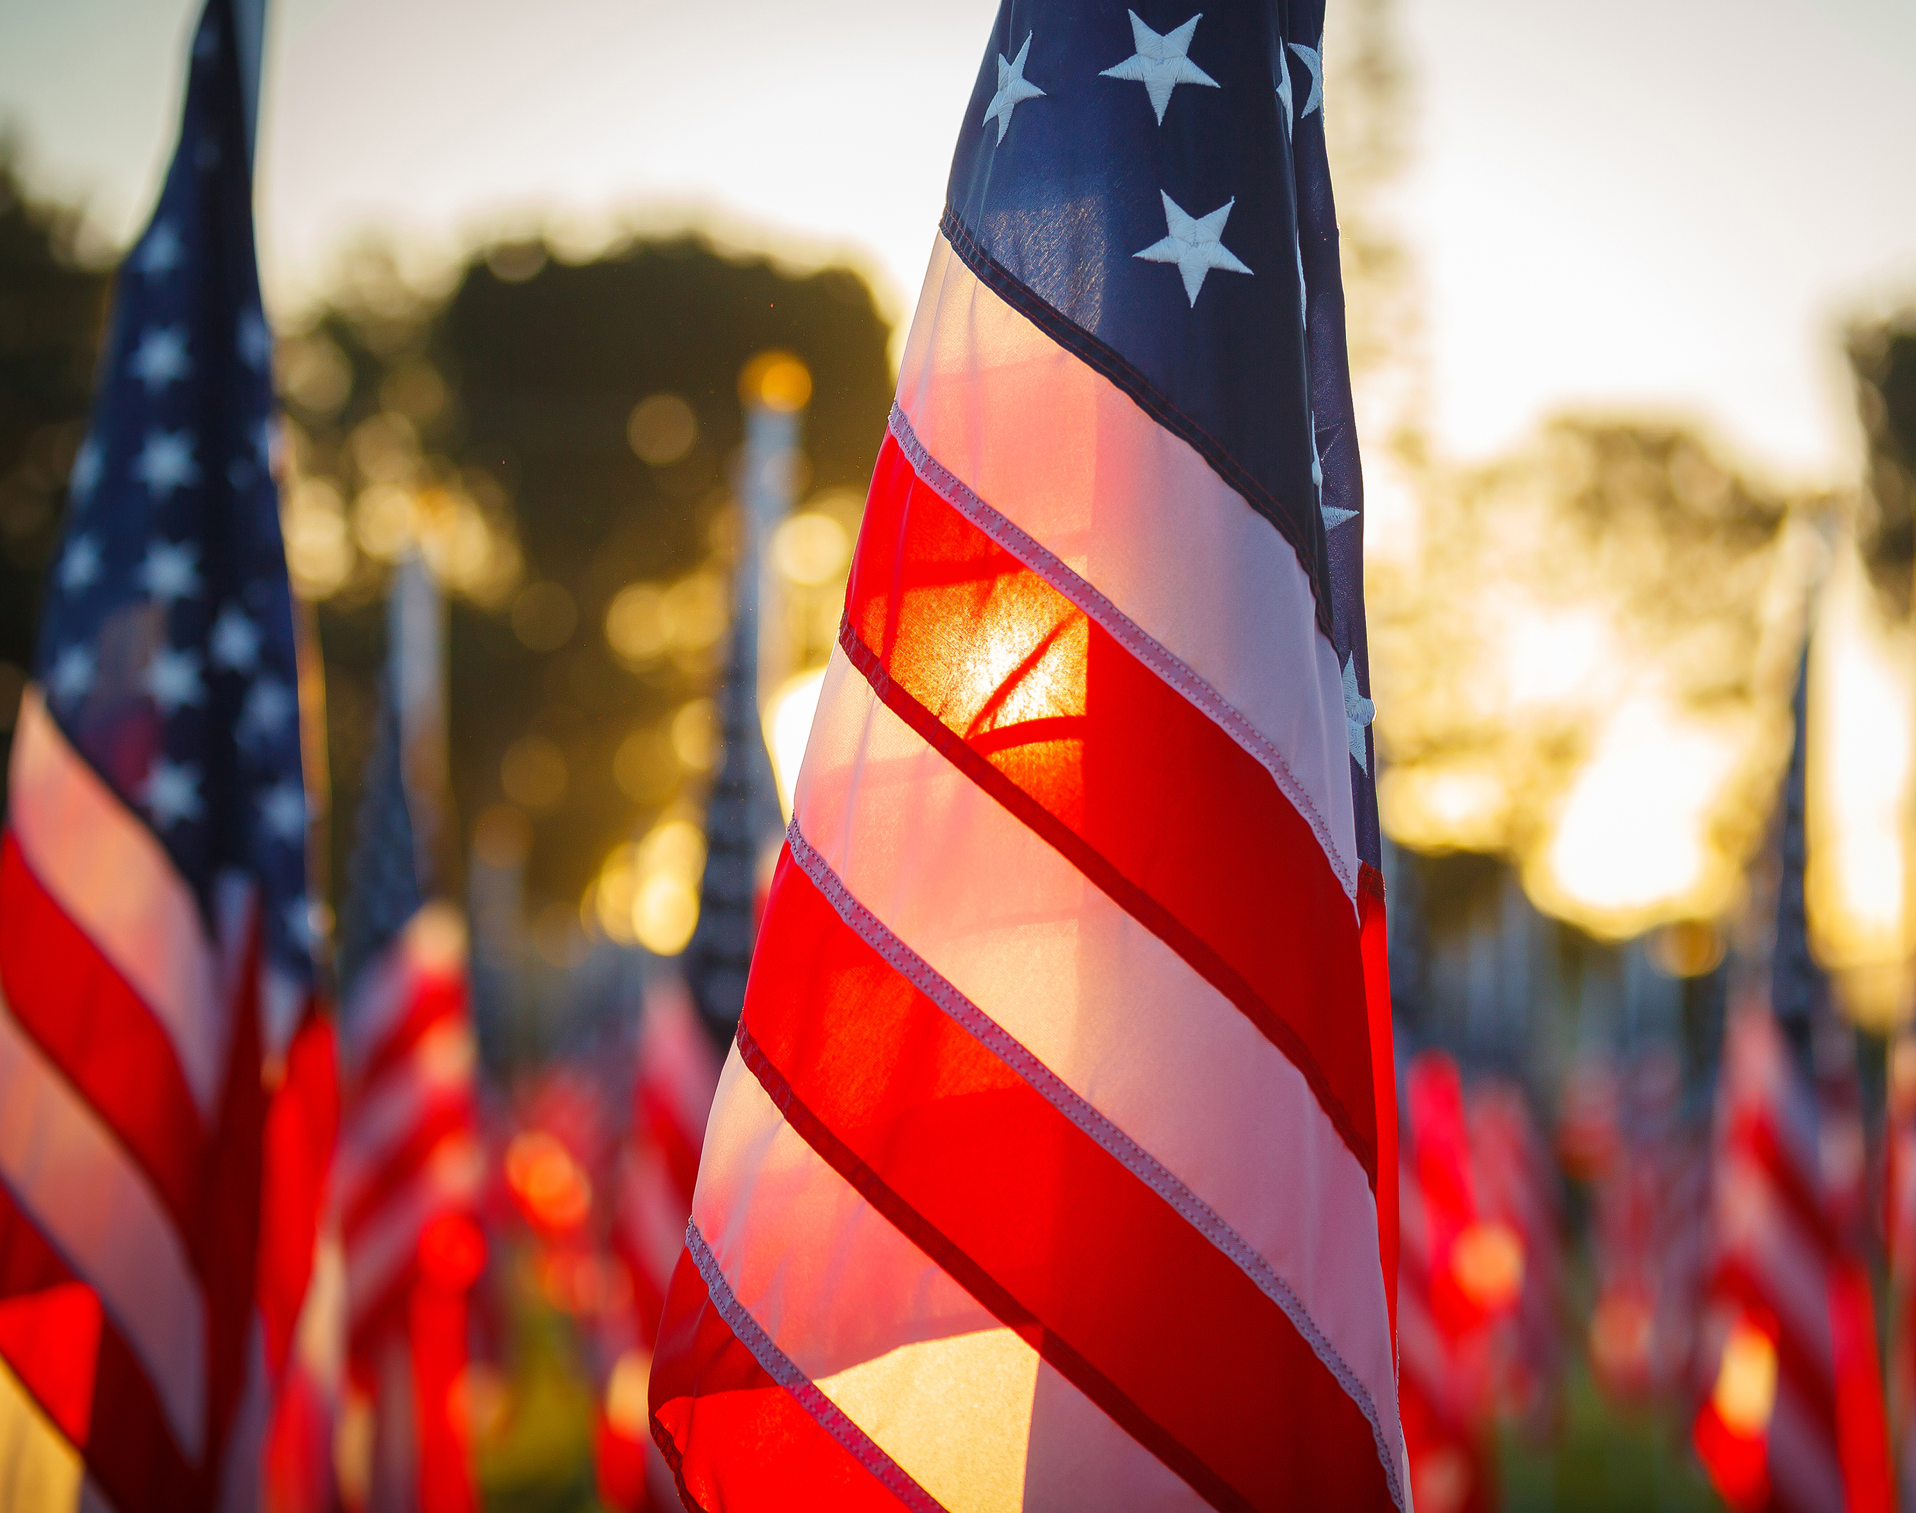
2026 PRIMARY ELECTION
MAY 19TH
ELECTION OFFICER TRAINING

Slide 2
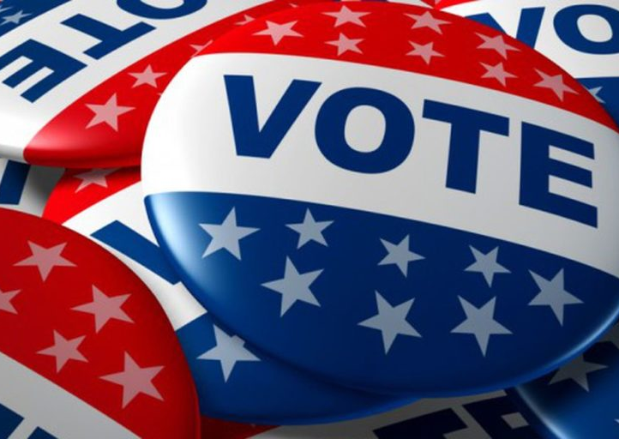
ELECTION OFFICER TRAINING AGENDA
EXCUSED AND EARLY VOTING INFORMATION
ELECTION OFFICER EXPECTATIONS
SBE FORMS
E-POLL BOOKS
VERITY SCAN AND TOUCHWRITER MACHINES
This Photo by Unknown author is licensed under CC BY-ND.

Slide 3
EXCUSED ABSENTEE VOTING
MAY 6TH, 7TH, 8TH, 11TH,12TH & 13TH.
SHELBY CO CLERKS OFFICE
501 WASHINGTON ST SHELBYVILLE KY 40065
8:30AM TO 4:30PM
EARLY VOTING
MAY 14TH 10:00AM TO 6:00PM
MAY 15TH 10:00AM TO 6:00PM
MAY 16TH 8:00AM TO 4:00PM
SHELBYVILLE CONFERENCE & WELCOME CENTER
219 7TH ST SHELBYVILLE
IF YOU ARE NOT WORKING AT YOUR HOME PRECINCT YOU MUST USE ONE OF THESE OPTIONS

Slide 4
Contacts:
Clerks Office 502-633-4410
Tony Harover 502-541-3294
Abby Dietrich 502-338-4356

Slide 5
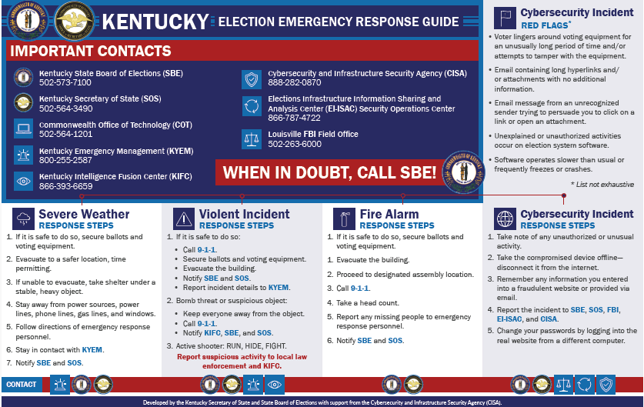

Slide 6
ATTENTION!
ALL VOTING MACHINES ARE TO BE UP AND RUNNING BY 6:00AM

Slide 7
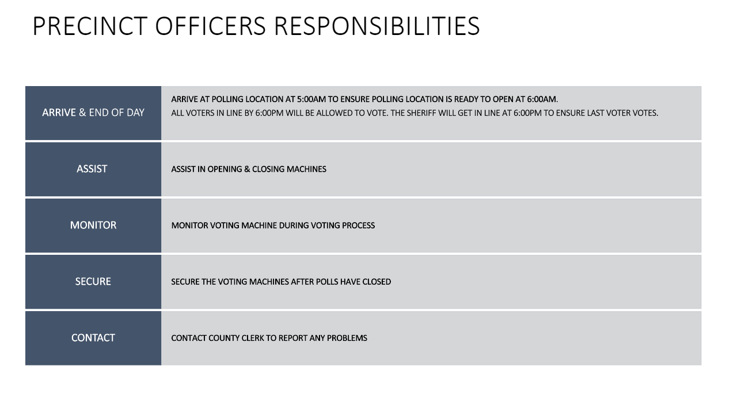

Slide 8
PERSONS ALLOWED IN POLLING LOCATION
ELECTION OFFICERS
VOTERS (INCLUDING MINORS WITH VOTERS)
LAW ENFORCEMENT OFFICERS
MEMBERS OF THE MEDIA FOR LIMITED PURPOSE OF FILMING THE VOTING PROCESS. THEY MAY NOT CONDUCT INTERVIEWS WITH VOTERS OR PRECINCT OFFICERS INSIDE THE POLLING LOCATION
CHALLENGERS

Slide 9
ALL FORMS LOCATED IN WHITE BINDER
PLEASE SIGN ALL FORMS REQUIRING A SIGNATURE FROM ALL OR ONE PRECINCT OFFICER(S)
OATH OF VOTER SBE32
VOTER ASSISTANCE SBE31
VOTER AFFIRMATION SBE71
ELECTION OFFICER AFFIRMATION SBE72
PRECINCT MAP
CITY STREET MAP (IF IN CITY LIMITS)
SAMPLE BALLOTS
SHERIFF REPORT SBE52
LIST OF ABSENTEE VOTERS
VERITY SCAN ENVELOPE
VERITY TOUCHWRITER ENVELOPE
NAMES TAGS
PRECINCT LOCATIONS LIST
VOTER REGISTRATION CARDS
E-POLL VERIFICATION SHEET

Slide 10
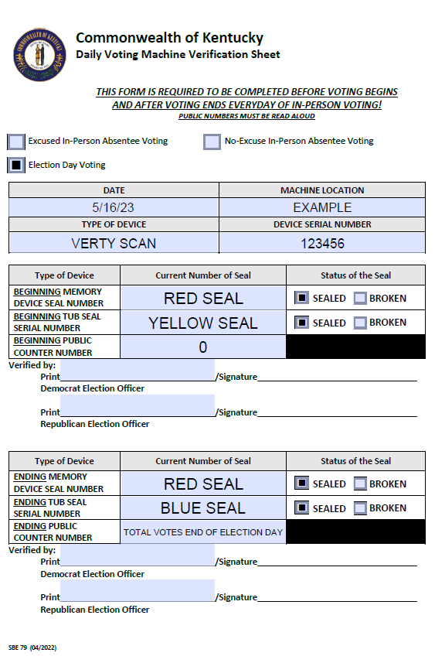
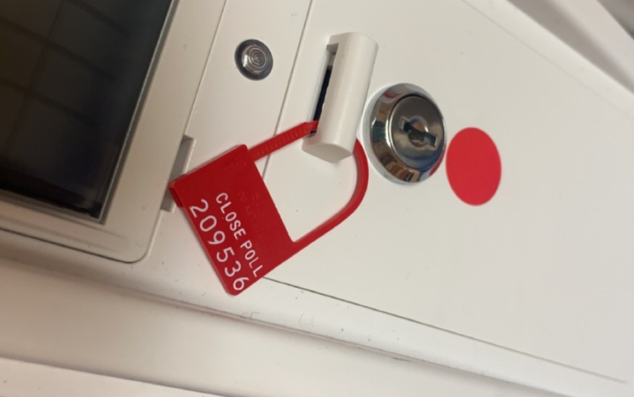
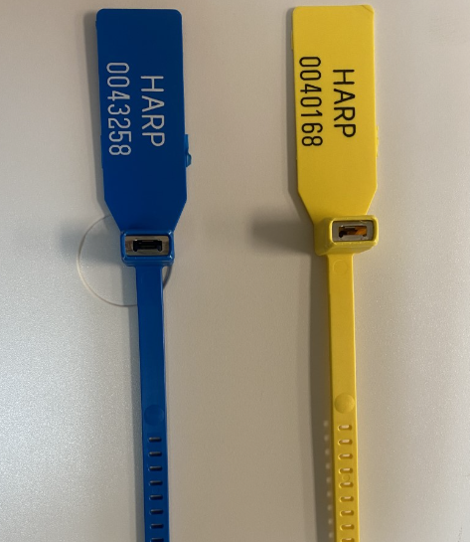
SBE 79 DAILY VOTING MACHINE VERIFICATION SHEET
LOCATED IN TOP PORTION OF VERITY MACHINE
BEFORE POLLS OPEN – PRECINCT OFFICERS (1 DEM & 1 REP)
ENTER IN BEGINNING SEAL NUMBERS (RED & YELLOW) AND THE PUBLIC COUNT (0).
AFTER POLLS CLOSE – PRECINCT OFFICERS (1 DEM & 1 REP)
ENTER ENDING SEAL NUMBERS (RED & BLUE) AND THE PUBLIC COUNT (TOTAL VOTES).

Slide 11
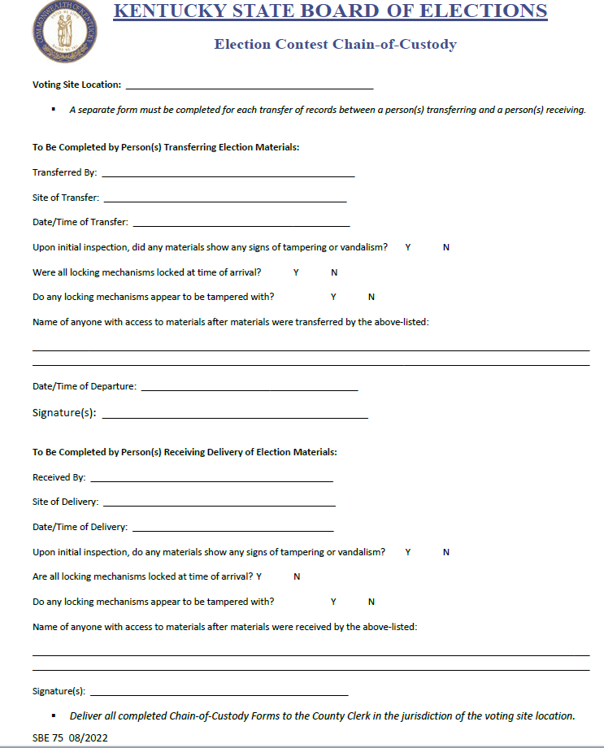
SBE 75 ELECTION CONTEST CHAIN OF CUSTODY :
THIS WILL BE TAPED ON TOP OF YOUR VERITY SCAN MACHINES.
COMPLETED BY ROAD DEPT
COMPLETED BY PRECINCT OFFICER

Slide 12
ELECTIONEERING
NO ONE IS PERMITTED TO DO ANY ELECTIONEERING WITHIN 100 FEET OF THE POLLING PLACE ON ELECTION DAY.
ELECTIONEERING IS NOT PERMITTED INSIDE THE POLLING AREA.
VOTER WEARING CAMPAIGN MATERIAL AT THE PRECINCT MAY NOT BE FORCED TO LEAVE THE POLLING PLACE BECAUSE THEY ARE WEARING SUCH AS T-SHIRTS, BUTTONS, HATS, ETC UNTIL GIVEN A CHANCE TO CAST A BALLOT.

Slide 13
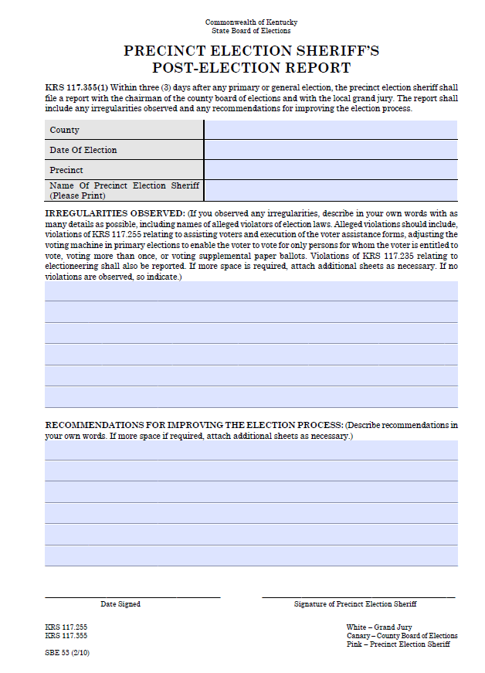
SHERIFF'S REPORT SBE 53
THIS REPORT DOCUMENTS MAJOR CONCERNS AND SUGGESTIONS FROM ELECTION DAY.
THE SHERIFF WILL COMPLETE AND SIGN THIS FORM.
IRREGULARITIES
RECOMMENDATIONS
SHERIFF SIGNATURE

Slide 14
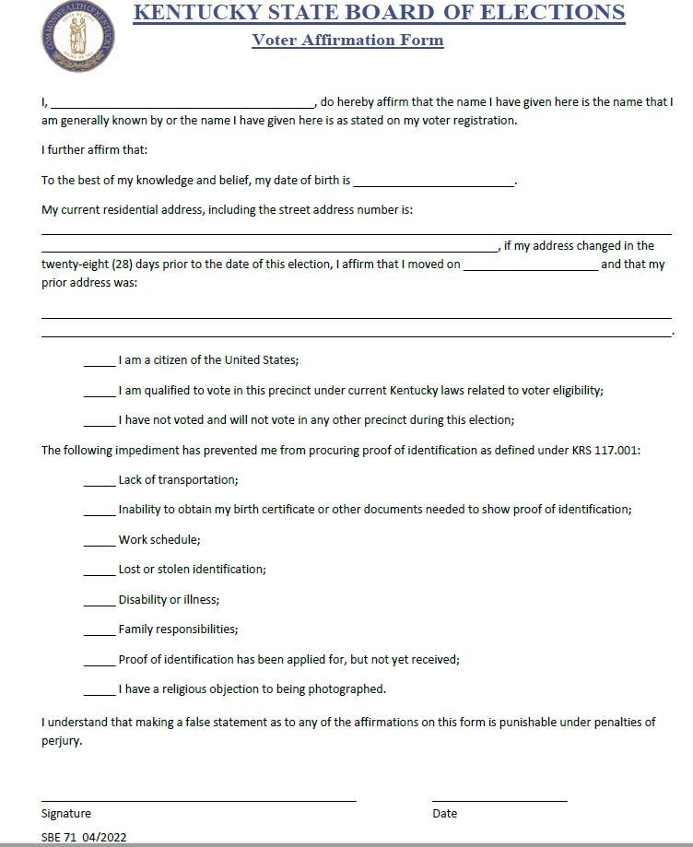
SBE 71 VOTER AFFIRMATION FORM
USE SBE 71 IF VOTER IS USING THE FOLLOWING FORMS OF IDENTIFICATION:
SOCIAL SECURITY CARD
SBE APPROVED COUNTY ID CARD
FOOD STAMP CARD
ELECTRONIC BENEFIT CARD
SUPPLEMENTAL NUTRITION CARD
CREDIT/DEBIT CARD

Slide 15
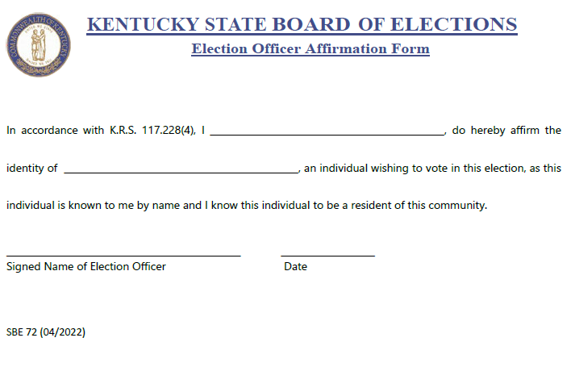
SBE 72 ELECTION OFFICER AFFIRMATION FORM
USE THIS FORM IF THE VOTER IS KNOWN BY THE ELECTION OFFICIAL BY NAME AS A RESIDENT OF THE COMMUNITY

Slide 16
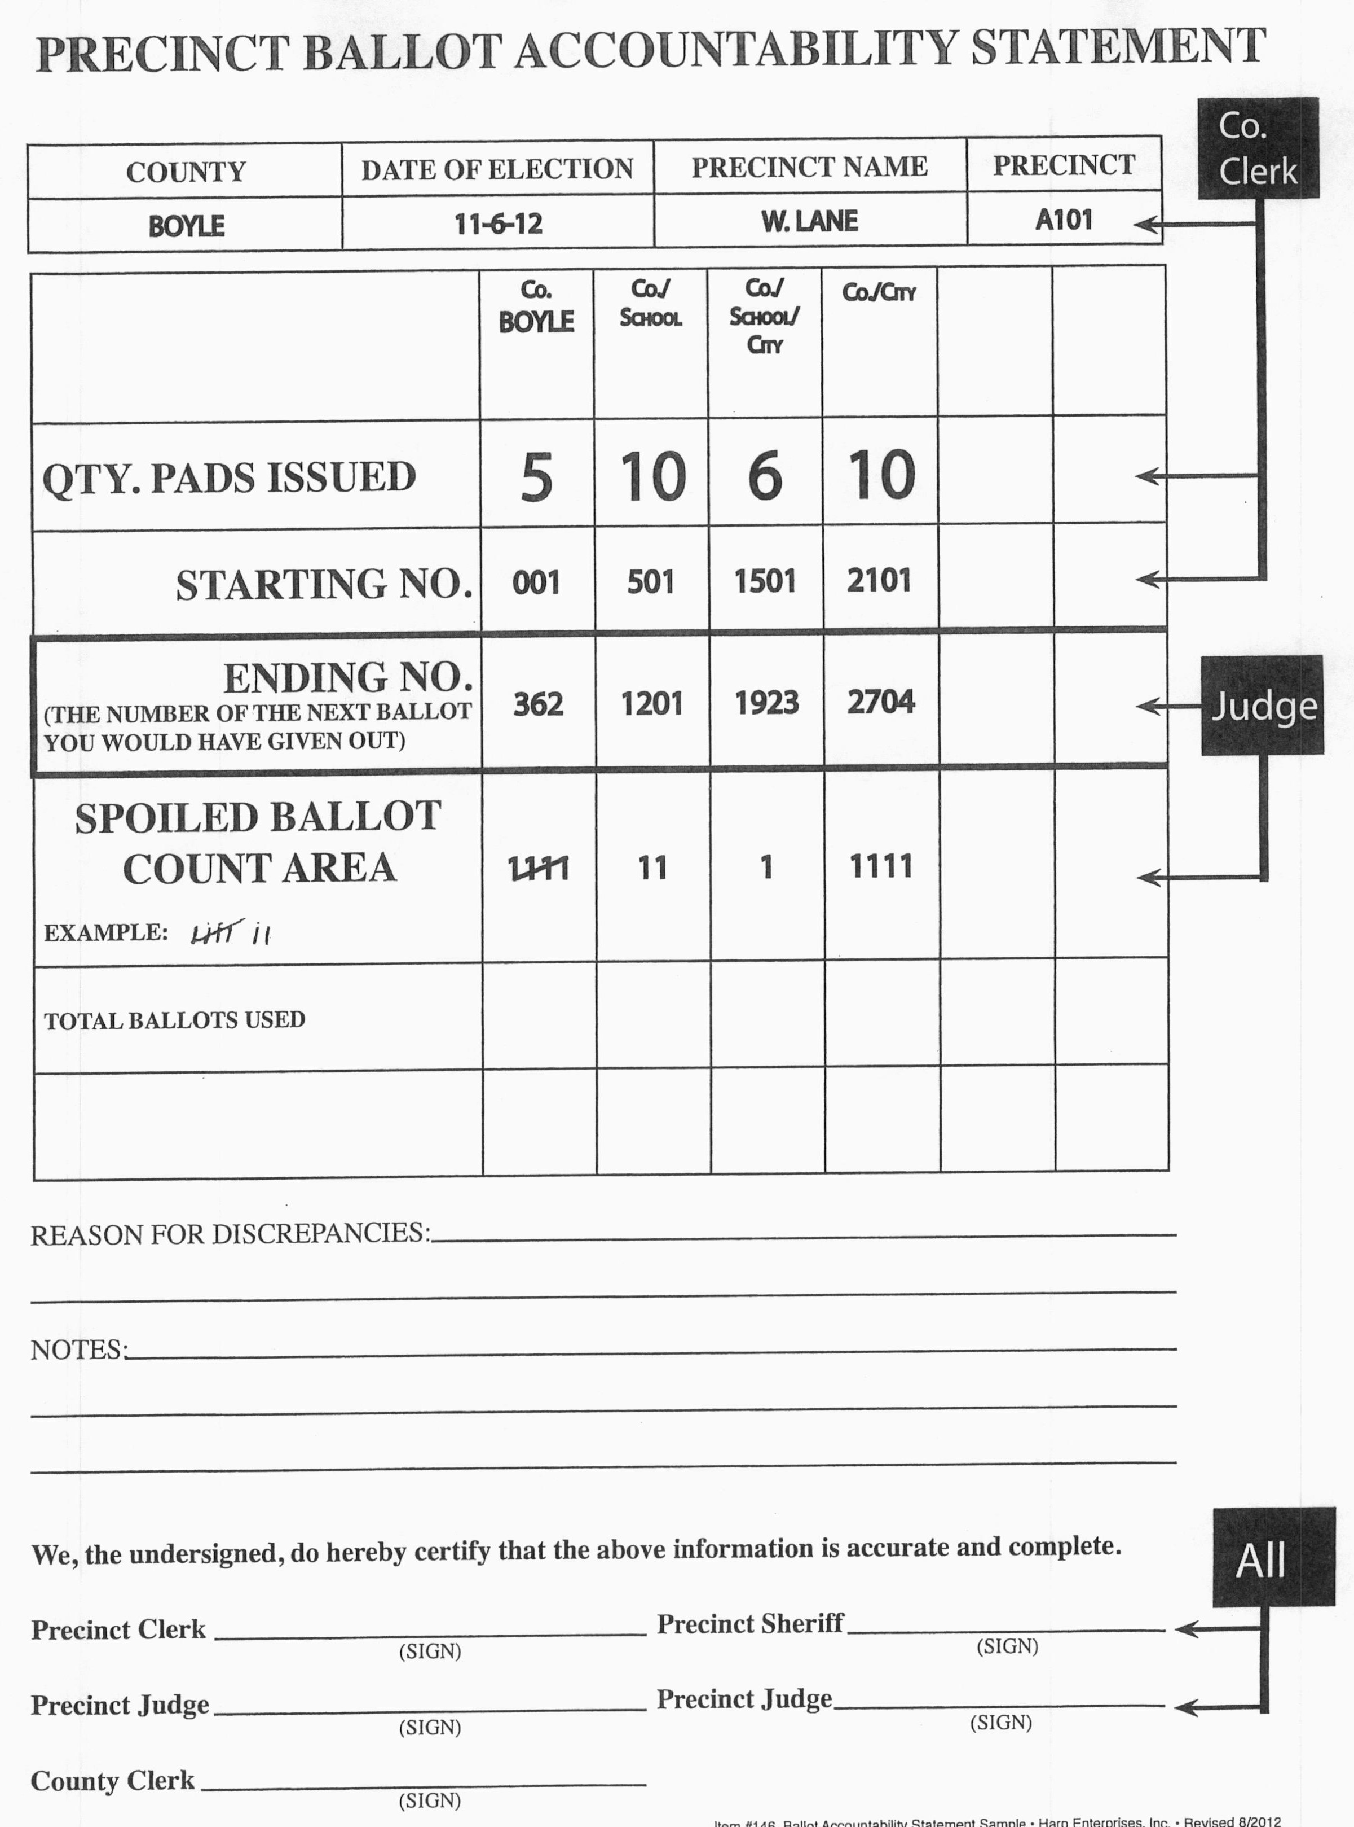
PRECINCT BALLOT ACCOUNTABILITY SHEET
THE STARTING NO. WILL BE ENTERED FOR YOU.
THE ENDING NO. WILL BE THE NEXT BALLOT NUMBER YOU WOULD HAVE ISSUED.
KEEP YOUR SPOILED BALLOT COUNT TO GET YOUR TOTAL BALLOTS USED
ALL PRECINCT OFFICERS MUST SIGN!
ENTERED BY CLERK'S OFFICE
ENDING NO.
SPOILED BALLOT COUNT
ALL PRECINCT OFFICERS MUST SIGN

Slide 17
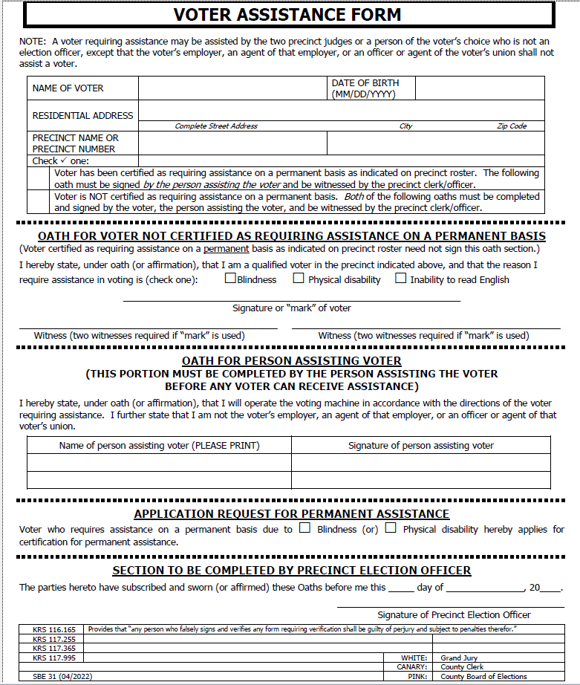
VOTER ASSISTANCE FORM
SBE 31
A VOTER MAY HAVE ASSISTANCE DUE TO:
BLINDNESS
PHYSICAL DISABILITY
INABILITY TO READ ENGLISH
IF THE VOTER HAS BEEN MARKED FOR PERMANENT ASSISTANCE, THE PERSON ASSISTING THE VOTER AND PRECINCT CLERK ASSISTING THE VOTER MUST SIGN SBE31
IF FILLING OUT SBE31 FOR 1ST TIME REQUIRES VOTER, PERSON ASSISTING AND PRECINCT CLERK MUST SIGN.
WHO MAY ASSIST THE VOTER?
ANY PERSON OF THE VOTERS CHOICE EXCEPT:
A VOTER'S EMPLOYER OR AGENT OF EMPLOYER
AN OFFICER OR AGENT OF VOTER'S UNION

Slide 18
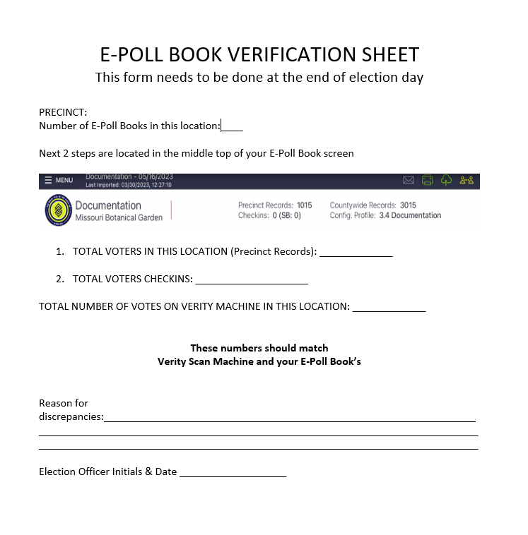
E-POLL BOOK VERIFICATION SHEET
ENTER IN NUMBER OF E-POLL BOOKS YOUR PRECINCT LOCATION.
TOTAL VOTERS IN THIS LOCATION (PRECINCT RECORDS):
TOTAL VOTERS CHECKINS:
ALL E-POLL BOOKS AND VERITY MACHINE TOTALS SHOULD MATCH.
LIST ANY DISCREPANCIES
INITIAL AND DATE

Slide 19
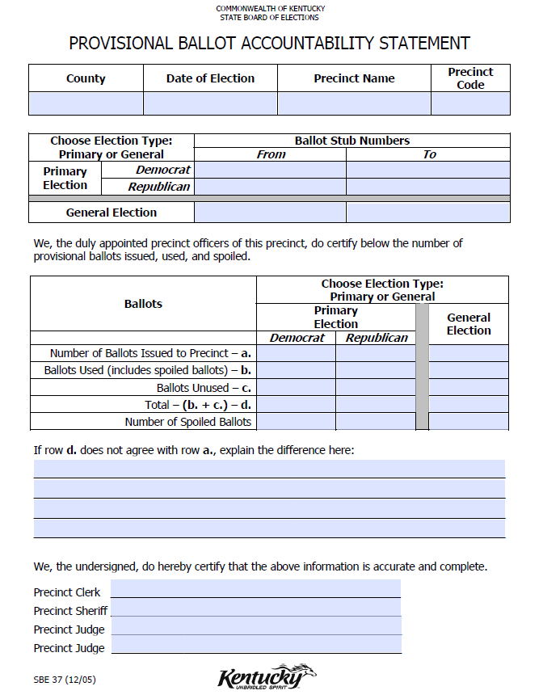
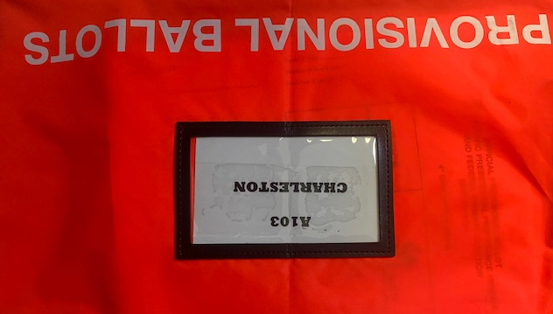
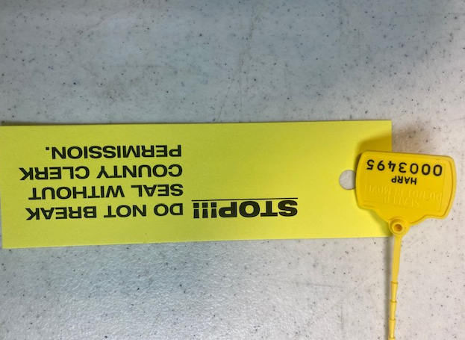
Provisional Ballot Steps begin at pg. 44
DO NOT BREAK YELLOW SEAL without contacting the county clerk's office first.
All Precinct Workers must sign Provisional Ballot Accountability Statement even if none are used.

Slide 20
SUPPLEMENTAL PROCESS
If a voter has moved MORE than 30 days from deadline, They must be added to E-Poll book in the new precinct.
Contact clerk's office oath of voter, new voter registration cards etc.
See page 22 in EPB Guide Supplemental Process
See page 12 in EPB Guide Process Voter
If voter has moved LESS 30 day's they will vote in same location.
If a voter has moved from another County they are NOT eligible to vote in Shelby County

Slide 21
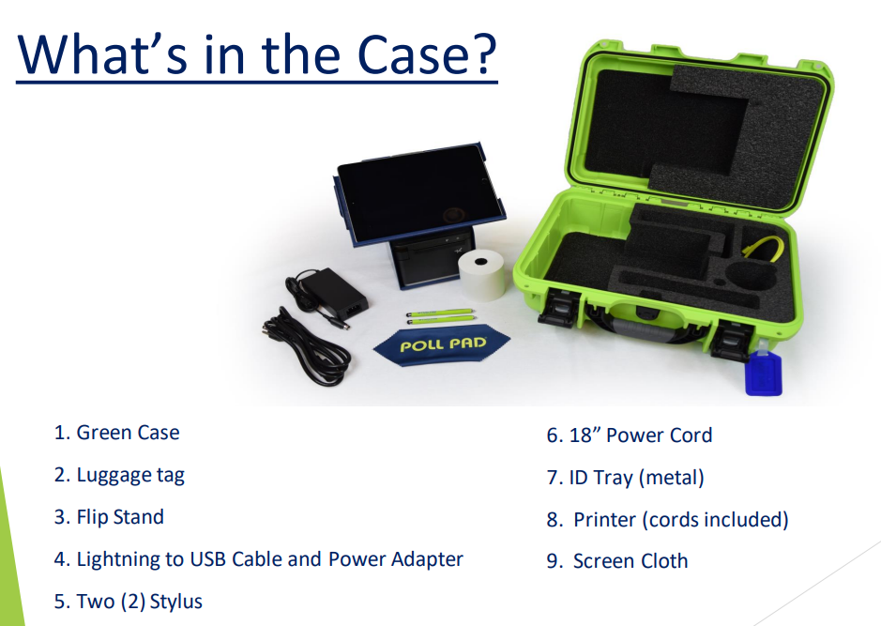

Slide 22
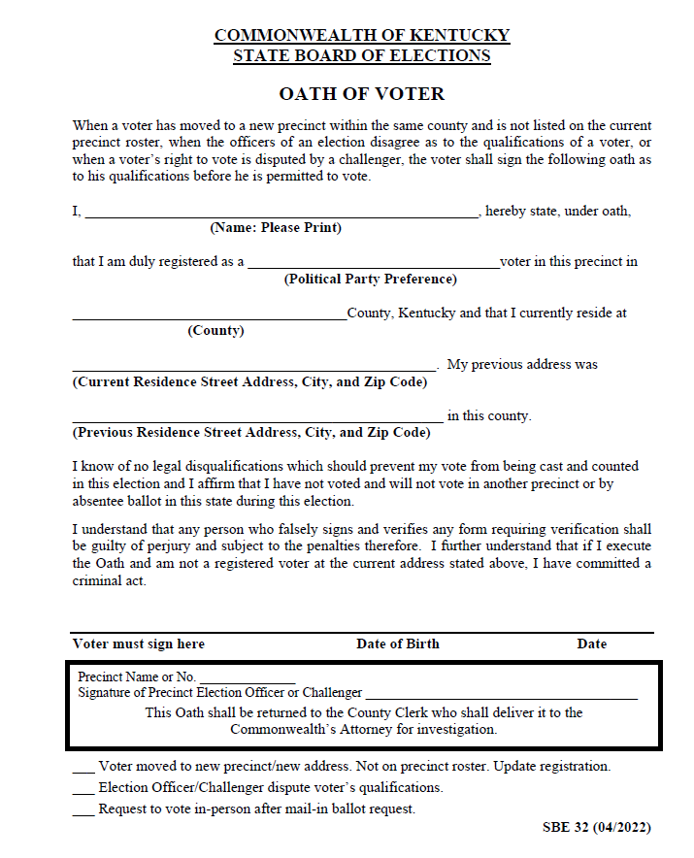
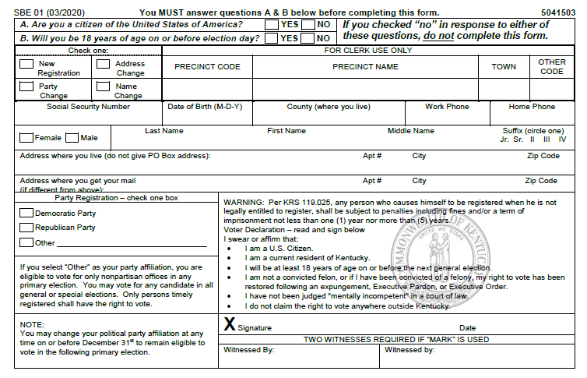
Oath of Voter and Voter Registration Card are still in paper form.
Supplemental Roster will be on your E-Poll Book.
Hands on training for this portion.
Tip: Have the voter step to the side with an precinct officer to fill out both forms once completed follow steps on E-Poll book to complete check in.

Slide 23
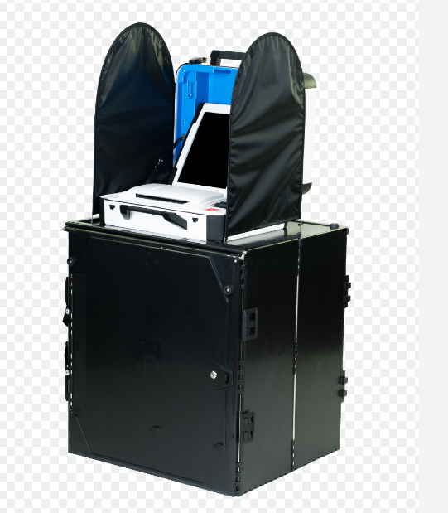
Verity Scan Setup
All Supplies are in the black bin
Ballot Bag
Supply Bag
E-poll Books
Extension Cords/Power Strip
Power Brick
Privacy Screens
Precinct Sign Tower

Slide 24
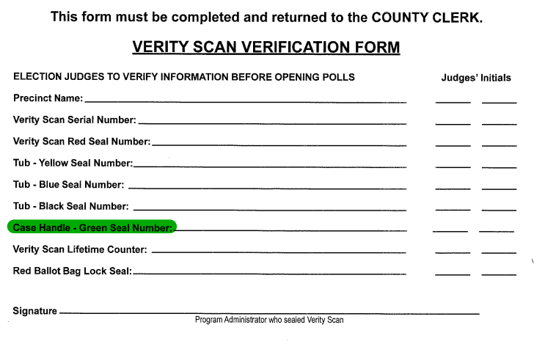
Verify GREEN Seal # on Verification Sheet!!

Slide 25
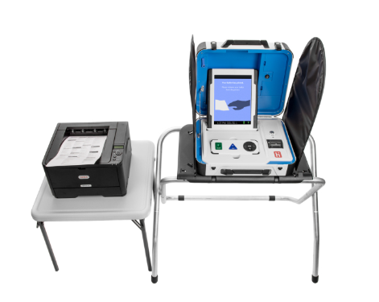
Verity Touch Writer Setup

Slide 26
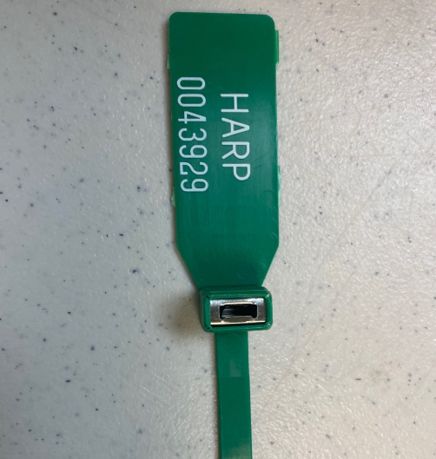
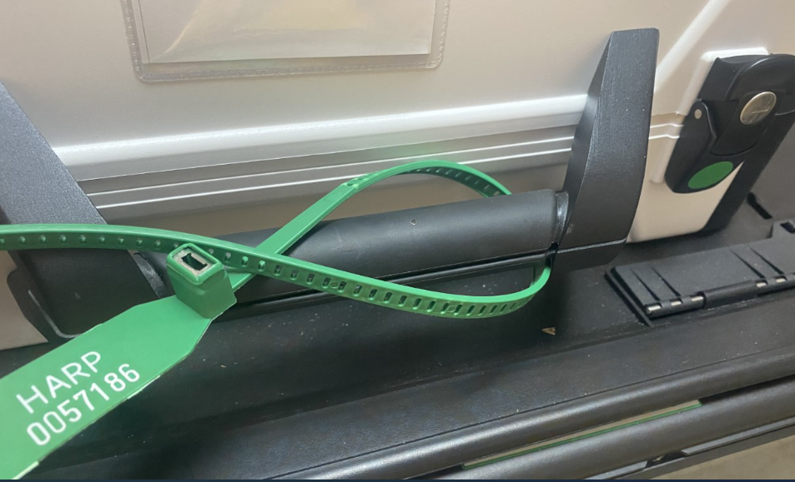
Attach GREEN seal to handle bars of the Verity Scan Machine

